Slide 1
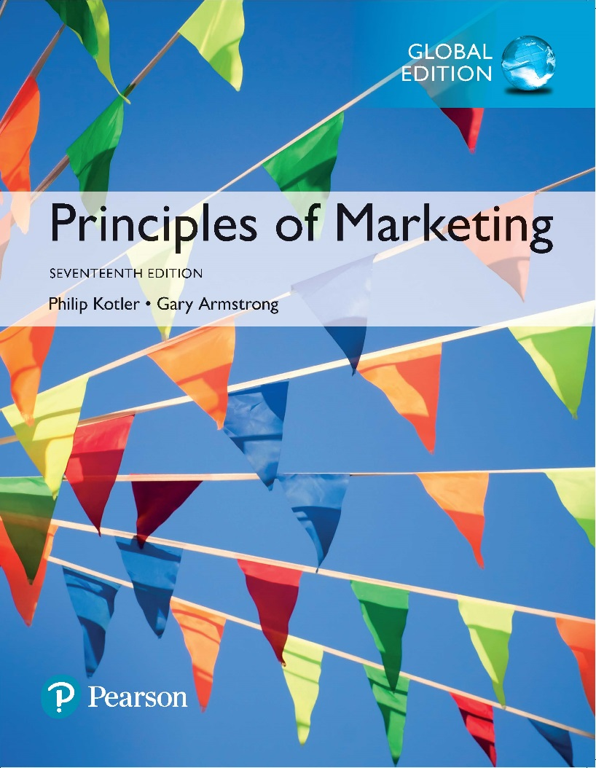
Principles of Marketing Seventeenth Edition
Chapter 9
Developing New Products and Managing the Product Life Cycle
Copyright © 2018 Pearson Education Ltd. All Rights Reserved.

Slide 2
Learning Objectives
9-1 Explain how companies find and develop new product ideas.
9-2 List and define the steps in the new product development process and the major considerations in managing this process.
9-3 Describe the stages of the product life cycle and how marketing strategies change during a product’s life cycle.
9-4 Discuss two additional product issues: socially responsible product decisions and international product and services marketing.

Slide 3
Learning Objective 1
Explain how companies find and develop new product ideas.

Slide 4
New Product Development Strategy
Ways to Obtain New Products
Acquisition refers to the buying of a whole company, a patent, or a license to produce someone else’s product.
New product development refers to original products, product improvements, product modifications, and new brands developed from the firm’s own research and development.
Notes:
A firm can obtain new products in two ways: through acquisition or through new product development efforts. In this chapter, we concentrate on new product development.
New products are important to both customers and the marketers who serve them: They bring new solutions and variety to customers’ lives, and they are a key source of growth for companies. In today’s fast-changing environment, many companies rely on new products for the majority of their growth.
Yet innovation can be very expensive and very risky. By one estimate, 66 percent of all new products introduced by established companies fail within two years. Why do so many new products fail? There are several reasons: overestimated market size, poor product design, or incorrect positioning, timing, pricing, or advertising.
So, companies face a problem: They must develop new products, but the odds weigh heavily against success. To create successful new products, a company must understand its consumers, markets, and competitors and develop products that deliver superior value to customers.

Slide 5
Learning Objective 2
List and define the steps in the new product development process and the major considerations in managing this process.

Slide 6
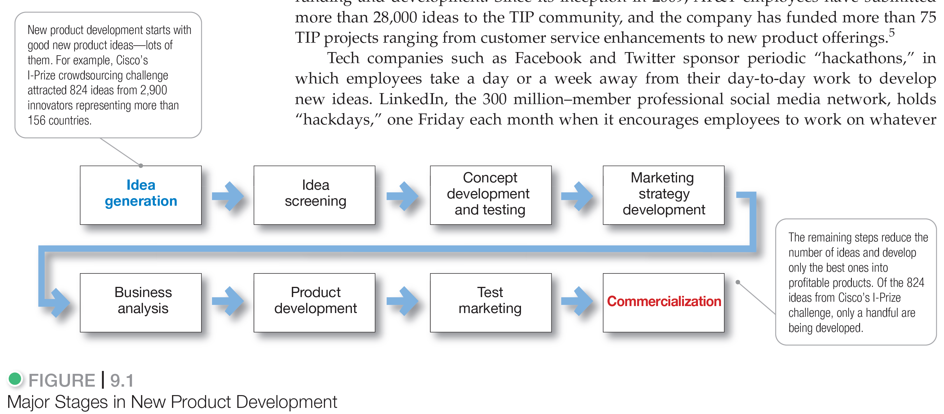

New Product Development Process
Notes:
A company must carry out strong new product planning and set up a systematic, customer-driven new product development process for finding and growing new products. Figure 9.1 shows the eight major steps in the process.
Product Ideas
New product development starts with good new product ideas—lots of them. For example, Cisco’s I-Prize crowdsourcing challenge
attracted 824 ideas from 2,900 innovators representing more than 156 countries.
Development
The remaining steps reduce the number of ideas and develop only the best ones into profitable products. Of the 824 ideas from Cisco’s I-Prize challenge, only a handful are being developed.

Slide 7
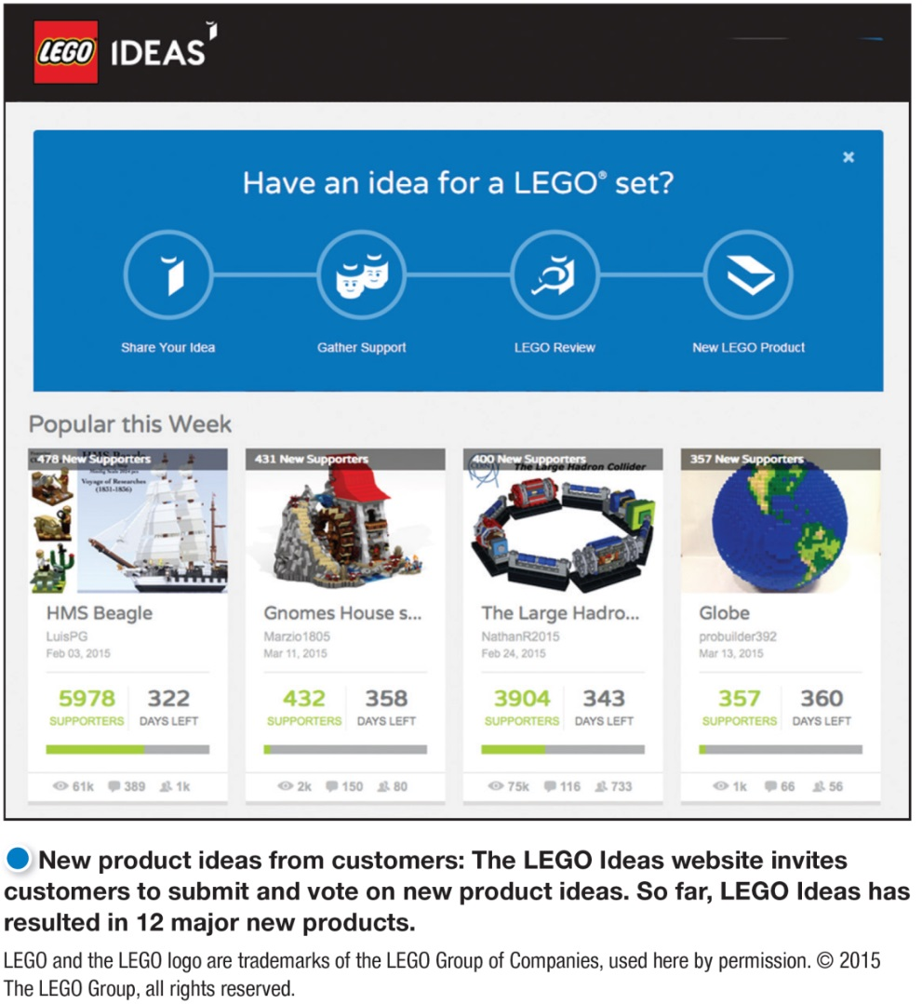
New Product Development Process
Idea Generation
Idea generation is the systematic search for new product ideas.
Sources of new product ideas
Internal
External
Notes:
Product quality is one of the marketer’s major positioning tools. Quality affects product or service performance; thus, it is closely linked to customer value and satisfaction. In the narrowest sense, quality can be defined as “freedom from defects.” But most marketers go beyond this narrow definition. Instead, they define quality in terms of creating customer value and satisfaction.
Total quality management (TQM) is an approach in which all of the company’s people are involved in constantly improving the quality of products, services, and business processes..
Today, companies are taking a return-on-quality approach, viewing quality as an investment and holding quality efforts accountable for bottom-line results.
Product quality has two dimensions: level and consistency. In developing a product, the marketer must first choose a quality level that will support the product’s positioning. Here, product quality means performance quality—the product’s ability to perform its functions.
Beyond quality level, high quality also can mean high levels of quality consistency. Here, product quality means conformance quality—freedom from defects and consistency in delivering a targeted level of performance. All companies should strive for high levels of conformance quality.

Slide 8
New Product Development Process
Idea Generation
Internal sources refer to the company’s own formal research and development, management and staff, and intrapreneurial programs.
External sources refer to sources outside the company such as customers, competitors, distributors, suppliers, and outside design firms.
Notes:
Internal Idea Sources
Using internal sources, the company can find new ideas through formal R&D, however, only 33 percent of companies surveyed rated traditional R&D as a leading source of innovation ideas.
Thus, beyond its internal R&D process, a company can pick the brains of its own people—executives, salespeople, scientists, engineers, and manufacturing staff. Many companies have developed successful internal social networks and intrapreneurial programs that encourage employees to develop new product ideas. For example, Google’s Innovation Time-Off program and 3M’s Dream Days encourage employees to spend a portion of their working time on their own projects, resulting in many other successful products.
Tech companies such as Facebook and Twitter sponsor periodic “hackathons,” in which employees take a day or a week away from their day-to-day work to develop new ideas. LinkedIn, the 250-million-member professional social media network, holds monthly “hackdays” and encourages employees to work on whatever they want that will benefit the company.
External Idea Sources
Distributors are close to the market and can pass along information about consumer problems and new product possibilities. Suppliers can tell the company about new concepts, techniques, and materials that can be used to develop new products. Walmart invites its thousands of would-be suppliers to submit product ideas and supporting videos through its “Get on the Shelf” program and then invites its customers to vote for the products they’d most like to see on shelves.
Competitors are another important source. Companies watch competitors’ ads to get clues about their new products. They buy competing new products, take them apart to see how they work, analyze their sales, and decide whether they should bring out a new product of their own. Other idea sources include trade magazines, shows, web sites, and seminars; government agencies; advertising agencies; marketing research firms; university and commercial laboratories; and inventors.
Perhaps the most important sources of new product ideas are customers themselves. The company can analyze customer questions and complaints to find new products that better solve consumer problems. Or it can invite customers to share suggestions and ideas. For example, the LEGO CUUSOO web site invites users to submit ideas for “the LEGO set of their dreams” and to vote for other users’ ideas. Ideas supported by 10,000 votes are reviewed internally with a chance of being put into production.

Slide 9
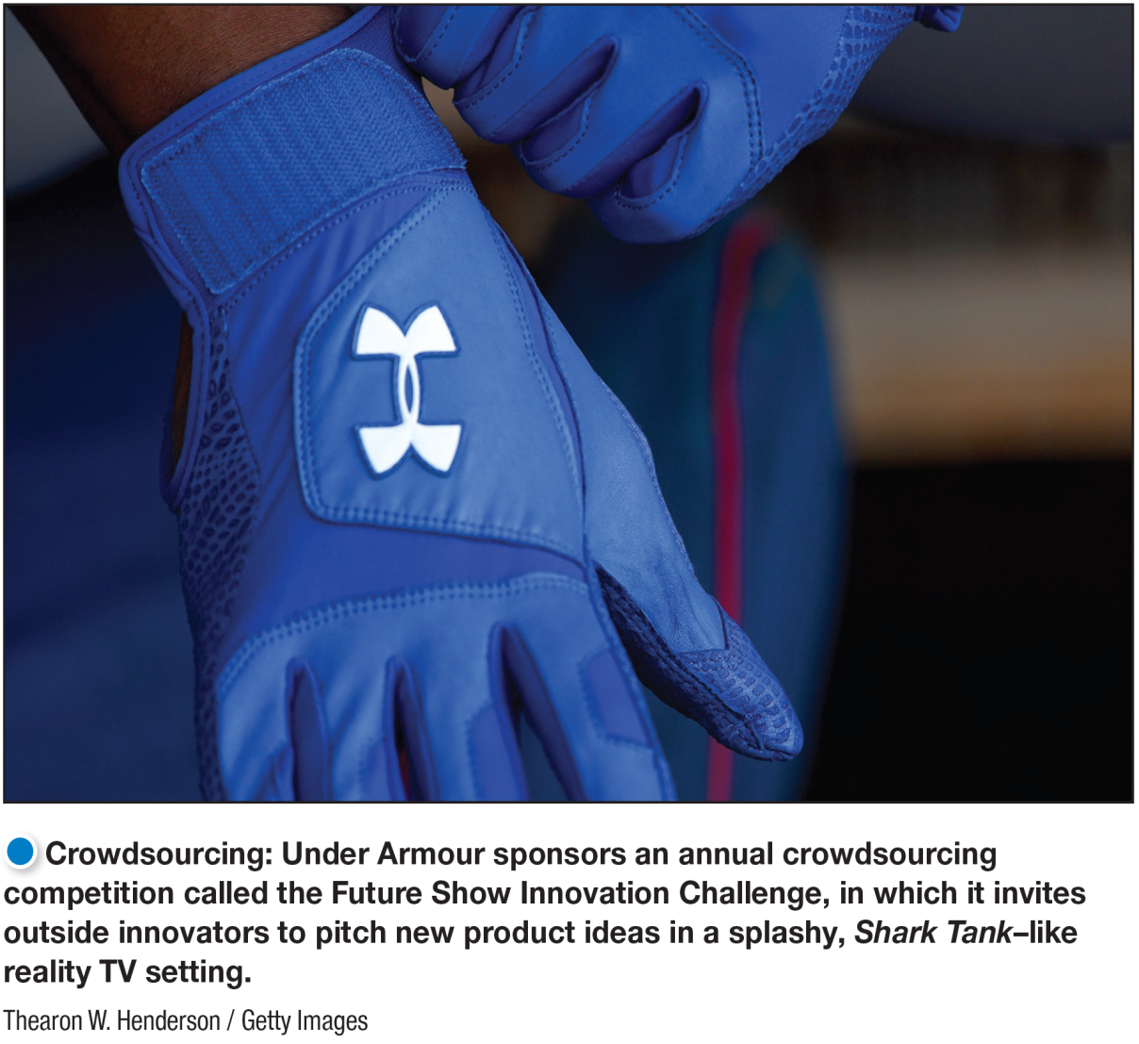
New Product Development Process
Idea Generation
Crowdsourcing involves inviting broad communities of people—customers, employees, independent scientists and researchers, and even the public at large—into the new product innovation process.
Notes:
Tapping into a breadth of sources—both inside and outside the company—can produce unexpected and powerful new ideas.
Crowdsourcing can produce a flood of innovative ideas. In fact, opening the floodgates to anyone and everyone can overwhelm the company with ideas—some good and some bad.
Truly innovative companies don’t rely only on one source or another for new product ideas. Instead, they develop extensive innovation networks that capture ideas and inspiration from every possible source, from employees and customers to outside innovators and multiple points beyond.

Slide 10
New Product Development Process
Idea Screening
Identify good ideas and drop poor ideas
R-W-W screening framework:
Is it real?
Can we win?
Is it worth doing?
Notes:
The purpose of idea generation is to create a large number of ideas. The purpose of the succeeding stages is to reduce that number. The first idea-reducing stage is idea screening. Product development costs rise greatly in later stages, so the company wants to pursue only those product ideas that will turn into profitable products.
Many companies require their executives to write up new product ideas in a standard format that can be reviewed by a new product committee. The write-up describes the product or the service, the proposed customer value proposition, the target market, and the competition. It makes some rough estimates of market size, product price, development time and costs, manufacturing costs, and rate of return. The committee then evaluates the idea against a set of general criteria. The company should be able to answer yes to all three R-W-W screening framework questions before developing the new product idea further.

Slide 11
New Product Development Process
Concept Development and Testing
Product idea is an idea for a possible product that the company can see itself offering to the market.
Product concept is a detailed version of the idea stated in meaningful consumer terms.
Product image is the way consumers perceive an actual or potential product.
Notes:
An attractive idea must then be developed into a product concept. It is important to distinguish between a product idea, a product concept, and a product image.

Slide 12

New Product Development Process
Concept Development and Testing
Concept testing refers to testing new product concepts with groups of target consumers.
Notes:
The slide shows Tesla’s initial all-electric roadster. Later, more-affordable mass-market models being developed will travel more than 300 miles on a single charge, recharge in 45 minutes from a normal 120-volt electrical outlet, and cost about one penny per mile to power.
Concept Development
Suppose a car manufacturer has developed a practical battery-powered, all-electric car. Its initial prototype is a sleek, sporty roadster convertible. In the near future it plans to introduce more-affordable, mass-market versions that will compete with recently introduced hybrid-electric or all-electric cars. Looking ahead, the marketer’s task is to develop this new product into alternative product concepts, find out how attractive each concept is to customers, and choose the best one.
Concept testing calls for testing new product concepts with groups of target consumers. The concepts may be presented to consumers symbolically or physically. Many firms routinely test new product concepts with consumers before attempting to turn them into actual new products.
After being exposed to the concept, consumers then may be asked to react to it by answering questions similar to those in Table 9.1. The answers to such questions will help the company decide which concept has the strongest appeal and the consumer’s intention to buy.

Slide 13
New Product Development Process
Marketing Strategy Development
Marketing strategy development is designing an initial marketing strategy for a new product based on the product concept.
Marketing strategy statement consists of:
Target market description
Value proposition planned
Sales, market-share, and marketing mix
Notes:
The marketing strategy statement consists of three parts.
The first part describes the target market; the planned value proposition; and the sales, market-share, and profit goals for the first few years.
The second part of the marketing strategy statement outlines the product’s planned price, distribution, and marketing budget for the first year.
The third part of the marketing strategy statement describes the planned long-run sales, profit goals, and marketing mix strategy.

Slide 14
New Product Development Process
Business Analysis
Business analysis is a review of the sales, costs, and profit projections for a new product to find out whether these factors satisfy the company’s objectives.
Notes:
Once management has decided on its product concept and marketing strategy, it can evaluate the business attractiveness of the proposal. Business analysis involves a review of the sales, costs, and profit projections for a new product to find out whether they satisfy the company’s objectives. If the business analysis satisfies the company’s objectives, the product can move to the product development stage.
To estimate sales, the company might look at the sales history of similar products and conduct market surveys. It can then estimate minimum and maximum sales to assess the range of risk. After preparing the sales forecast, management can estimate the expected costs and profits for the product, including marketing, R&D, operations, accounting, and finance costs. The company then uses the sales and costs figures to analyze the new product’s financial attractiveness.

Slide 15
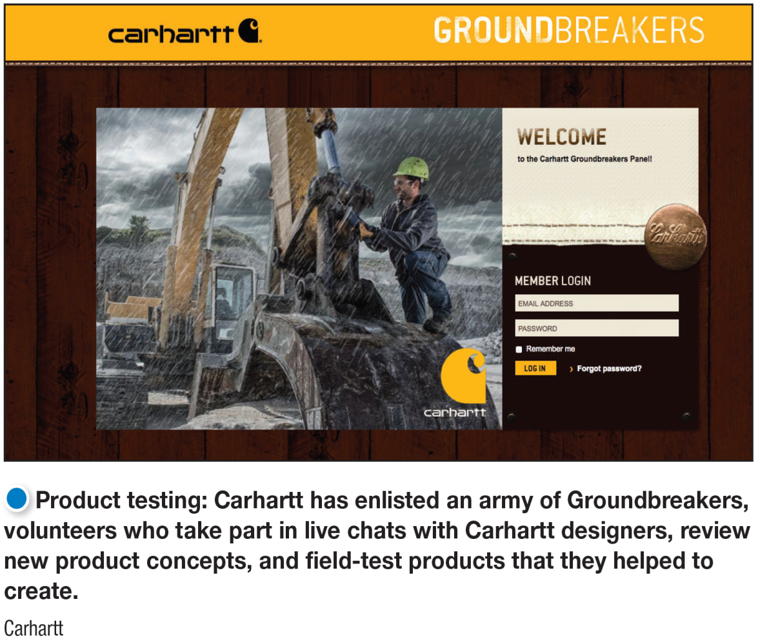
New Product Development Process
Product Development
Product development is developing the product concept into a physical product to ensure that the product idea can be turned into a workable market offering.
Notes:
Product testing: For many new product concepts, a product may exist only as a word description, a drawing, or perhaps a crude mock-up. If the product concept passes the business test, it moves into product development.
Here, R&D or engineering develops the product concept into a physical product. The product development step, however, now calls for a huge jump in investment. It will show whether the product idea can be turned into a workable product. Often, products undergo rigorous tests to make sure that they perform safely and effectively, or that consumers will find value in them.
Marketers often involve actual customers in product development and testing. Carhartt, maker of durable workwear and outerwear, has enlisted an army of Groundbreakers, “hard working men and women to help us create our next generation of products.” These volunteers take part in live chats with Carhartt designers, review new product concepts, and field test products that they helped to create. A new product must have the required functional features and also convey the intended psychological characteristics.

Slide 16
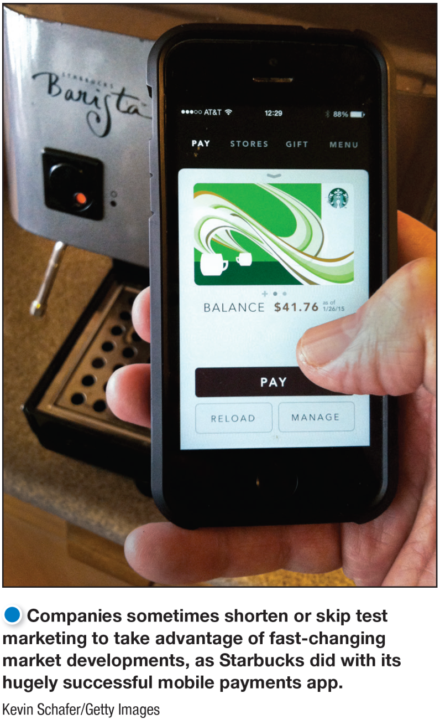
New Product Development Process
Test Marketing
Test marketing is the stage of new product development in which the product and its proposed marketing program are tested in realistic market settings.
Notes:
Companies sometimes shorten or skip test marketing to take advantage of fast-changing market developments, as Post did in launching Post Honey Bunches of Oats Greek Honey Crunch cereal in record time.
Test marketing lets the company test the product and its entire marketing program—targeting and positioning strategy, advertising, distribution, pricing, branding and packaging, and budget levels.

Slide 17
New Product Development Process
Test Marketing
Marketing Strategy Development
When test marketing is likely
New product with large investment
Uncertainty about product or marketing program
When test marketing is unlikely
Simple line extension
Copy of competitor product
Low costs
Management confidence
Notes:
The amount of test marketing needed varies with each new product. When introducing a new product requires a big investment, when the risks are high, or when management is not sure of the product or its marketing program, a company may do a lot of test marketing. For instance, Taco Bell took three years and 45 prototypes before introducing Doritos Locos Tacos, now the most successful product launch in the company’s history.
However, test marketing costs can be high, and testing takes time that may allow market opportunities to slip by or competitors to gain advantages. This slide list some circumstances where a company may do little or no test marketing. Companies may also shorten or skip testing to take advantage of fast-changing market developments.
As an alternative to extensive and costly standard test markets, companies can use controlled test markets or simulated test markets. In controlled test markets, new products and tactics are tested among controlled panels of shoppers and stores.
Using simulated test markets, researchers measure consumer responses to new products and marketing tactics in laboratory stores or simulated online shopping environments. Both controlled test markets and simulated test markets reduce the costs of test marketing and speed up the process.

Slide 18
New Product Development Process
Commercialization
Commercialization involves introducing a new product
into the market.
When to launch?
Where to launch?
Planned market rollout?
Notes:
Test marketing gives management the information needed to make a final decision about whether to launch the new product. If the company goes ahead with commercialization—introducing the new product into the market—it will face high costs
A company launching a new product must first decide on introduction timing. If the new product will eat into the sales of other company products, the introduction may be delayed. If the product can be improved further, or if the economy is down, the company may wait until the following year to launch it. However, if competitors are ready to introduce their own competing products, the company may push to introduce its new product sooner.
Next, the company must decide where to launch the new product—in a single location, a region, the national market, or the international market. Some companies may quickly introduce new models into the full national market. Companies with international distribution systems may introduce new products through swift global rollouts. For example, Microsoft launched its Windows 8 operating system with a massive $1 billion global marketing campaign spanning 42 countries.

Slide 19
Learning Objective 3
Describe the stages of the product life cycle and how marketing strategies change during a product’s life cycle.
Notes:
After dividing the market into segments, it’s time to answer that first seemingly simple marketing strategy question we raised in Figure 7.1: Which customers will the company serve?
The firm now has to decide how many and which segments it can serve best. We now look at how companies evaluate and select target segments.

Slide 20
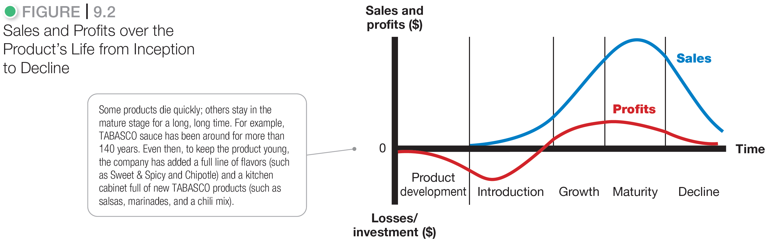
Product Life-Cycle Strategies
Notes:
The product life cycle (PLC), Figure 9.2, is the course of a product’s sales and profits over its lifetime. It involves five distinct stages: product development, introduction, growth, maturity, and decline.
Discussion Question
Name a product at each stage of the PLC.

Slide 21
Product Life-Cycle Strategies
Product development
Zero sales and increasing investment costs
Introduction
Slow sales and nonexistent profits
Growth
Rapid market acceptance and increasing profits
Maturity
Slow sales growth and profits level off or decline
Decline
Sales fall off and profits drop
Notes:
Product development begins when the company finds and develops a new product idea.
Introduction: Profits are nonexistent in this stage because of the heavy expenses of product introduction.
Growth is a period of rapid market acceptance and increasing profits.
Maturity: Profits level off or decline because of increased marketing outlays to defend the product against competition.
Decline is the period when sales fall off and profits drop.
Not all products follow all five stages of the PLC. Some products are introduced and die quickly; others stay in the mature stage for a long, long time. Some enter the decline stage and are then cycled back into the growth stage through strong promotion or repositioning. It seems that a well-managed brand could live forever. Examples of well known brands that have been around for at least 100 years include Coca-Cola, Gillette, Budweiser, American Express, TABASCO sauce, and Life Savers Mints.
The PLC concept can describe a product class, a product form, or a brand. The PLC concept applies differently in each case. Product classes have the longest life cycles; the sales of many product classes stay in the mature stage for a long time. Product forms, in contrast, tend to have the standard PLC shape. Product forms such as “dial telephones,” “VHS tapes,” and “film cameras” passed through a regular history of introduction, rapid growth, maturity, and decline.
A specific brand’s life cycle can change quickly because of changing competitive attacks and responses. For example, although laundry soaps (product class) and powdered detergents (product form) have enjoyed fairly long life cycles, the life cycles of specific brands have tended to be much shorter.

Slide 22
Product Life-Cycle Strategies
Introduction Stage
Slow sales growth
Little or no profit
High distribution and promotion expenses
Notes:
The introduction stage starts when a new product is first launched. Well-known products such as frozen foods and HDTVs lingered for many years before they entered a stage of more rapid growth.
In this stage profits are negative or low because of the low sales and high distribution and promotion expenses. Firms focus their selling on those buyers who are the most ready to buy.
A company, especially the market pioneer, must choose a launch strategy that is consistent with the intended product positioning. It should realize that the initial strategy is just the first step in a grander marketing plan for the product’s entire life cycle. If the pioneer chooses its launch strategy to make a “killing,” it may be sacrificing long-run revenue for the sake of short-run gain. The pioneer has the best chance of building and retaining market leadership if it plays its cards correctly from the start.

Slide 23
Product Life-Cycle Strategies
Growth Stage
Sales increase
New competitors enter the market
Profits increase
Economies of scale
Consumer education
Lowering prices to attract more buyers
Notes:
If the new product satisfies the market, it will enter a growth stage. The early adopters will continue to buy, and later buyers will start following their lead, especially if they hear favorable word of mouth.
As new competitors enter the market, they will introduce new product features, and the market will expand. The increase in competitors leads to an increase in the number of distribution outlets, and sales jump just to build reseller inventories. Companies keep their promotion spending at the same or a slightly higher level. Educating the market remains a goal, but now the company must also meet the competition.
Profits increase during the growth stage as promotion costs are spread over a large volume and as unit manufacturing costs decrease. The firm uses several strategies to sustain rapid market growth as long as possible:
Improving product quality
Adding new product features and models
Entering new market segments and new distribution channels
Shifting some advertising from awareness to building product conviction and purchase
Lowering prices at the right time to attract more buyers
In the growth stage, the firm faces a trade-off between high market share and high current profit. By spending a lot of money on product improvement, promotion, and distribution, the company can capture a dominant position. In doing so, however, it gives up maximum current profit, which it hopes to make up in the next stage.

Slide 24
Product Life-Cycle Strategies
Maturity Stage
Slowdown in sales
Many suppliers
Substitute products
Overcapacity leads to competition
Increased promotion and R&D to support sales and profits
Notes:
The maturity stage normally lasts longer than the previous stages, and it poses strong challenges to marketing management. Most products are in the maturity stage of the life cycle, and therefore most of marketing management deals with the mature product.
The slowdown in sales growth results in many producers with many products to sell. In turn, this overcapacity leads to greater competition and a drop in profit. Some of the weaker competitors start dropping out, and the industry eventually contains only well-established competitors.
Although many products in the mature stage appear to remain unchanged for long periods, most successful ones are actually evolving to meet changing consumer needs. Product managers should do more than simply ride along with or defend their mature products—a good offense is the best defense.
They should consider modifying the market, product offering, and marketing mix as discussed on the next slide.

Slide 25
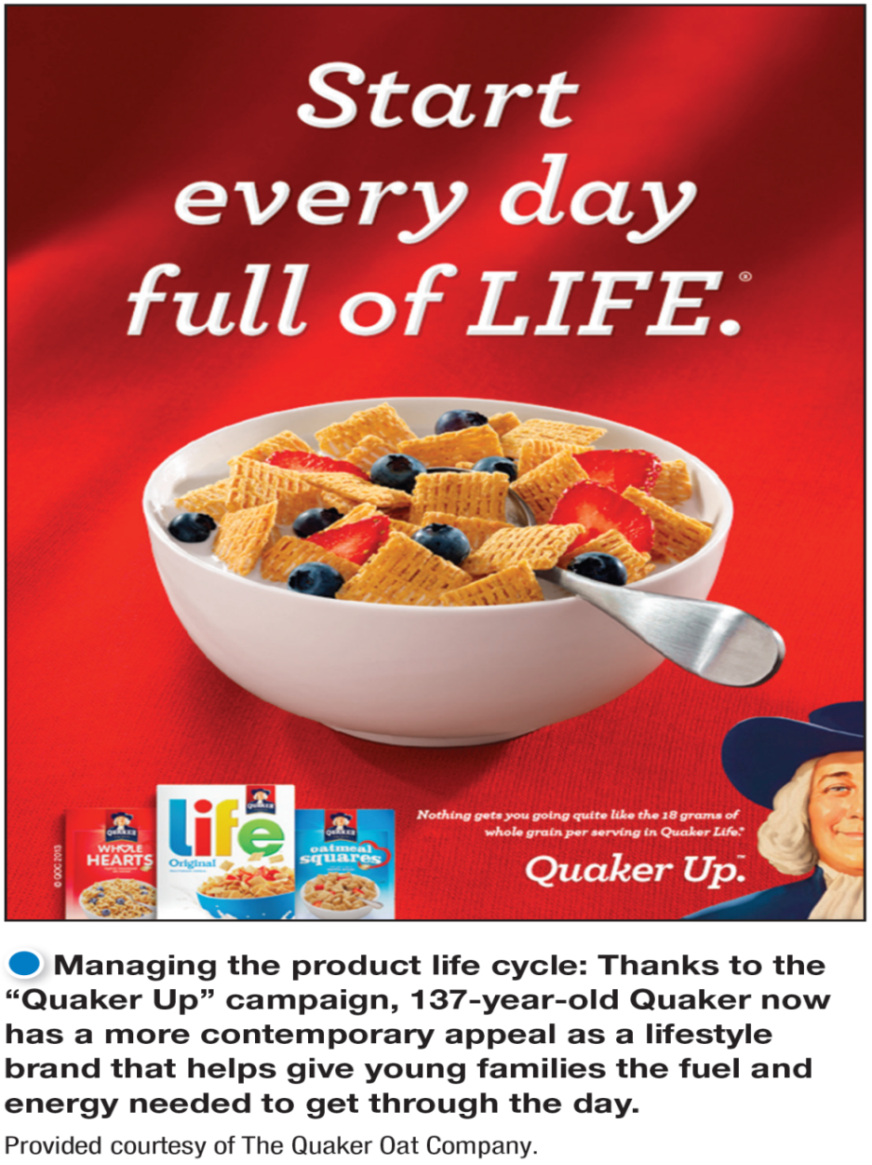
Product Life-Cycle Strategies
Maturity Stage
Modification Strategies
Modify the market
Modify the product
Modify the marketing mix
Notes:
Inspiring more usage: Thanks to the “Quaker Up” campaign, 137-year-old Quaker now has a more contemporary appeal as a lifestyle
brand that helps give young families the fuel and energy needed to get through the day. When modifying the market, the company tries to increase consumption by finding new users and new market segments for its brands.
Modifying the product involves changing characteristics such as quality, features, style, or packaging to attract new users and inspire more usage. The company can improve the product’s styling and attractiveness or improve the product’s quality and performance—durability, reliability, speed, and taste.
Modifying the marketing mix involves improving sales by changing one or more marketing mix elements. The company can offer new or improved services to buyers. It can cut prices to attract new users and competitors’ customers. It can launch a better advertising campaign or use aggressive sales promotions—trade deals, cents-off, premiums, and contests. In addition to pricing and promotion, the company can also move into new marketing channels to help serve new users.

Slide 26
Product Life-Cycle Strategies
Decline Stage
Maintain the product
Harvest the product
Drop the product
Notes:
The sales of most product forms and brands eventually dip. The decline may be slow, as in the cases of stamps and oatmeal cereal, or rapid, as in the case of VHS tapes. Sales may plunge to zero, or they may drop to a low level where they continue for many years. This is the decline stage. Sales decline for many reasons, including technological advances, shifts in consumer tastes, and increased competition.
Carrying a weak product can be very costly to a firm, and not just in profit terms. There are many hidden costs. A weak product may take up too much time and resources that might be better used to make “healthy” products more profitable, and a product’s failing reputation can cause customer concerns about the company and its other products. The biggest cost may well lie in the future. Keeping weak products delays the search for replacements, creates a lopsided product mix, hurts current profits, and weakens the company’s foothold on the future.
For these reasons, companies must identify products in the decline stage and decide whether to maintain, harvest, or drop them. Management may decide to maintain its brand, repositioning or reinvigorating it in hopes of moving it back into the growth stage of the product life cycle. Management may decide to harvest the product, which means reducing various costs (plant and equipment, maintenance, R&D, advertising, sales force), hoping that sales hold up. Finally, management may decide to drop the product from its line. The company can sell the product to another firm or simply liquidate it at salvage value. If the company plans to find a buyer, it will not want to run down the product through harvesting.
On the next two slides, Table 9.2 summarizes the key characteristics of each stage of the PLC. The table also lists the marketing objectives and strategies for each stage.

Slide 27
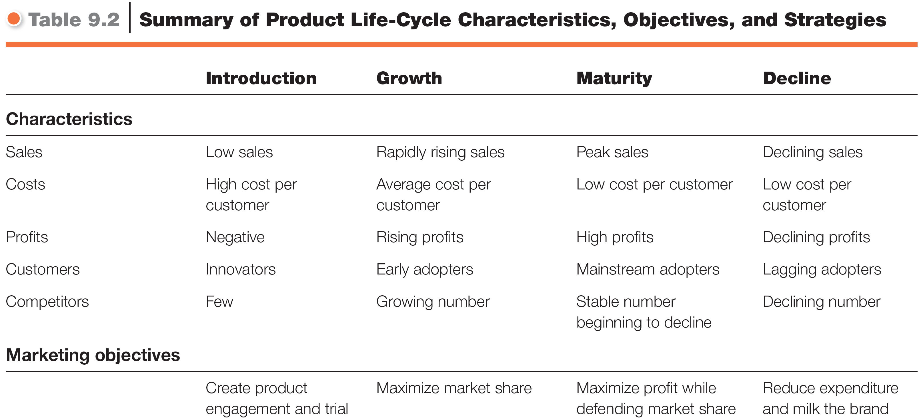
Product Life-Cycle Strategies
Table 9.2 Part I

Slide 28
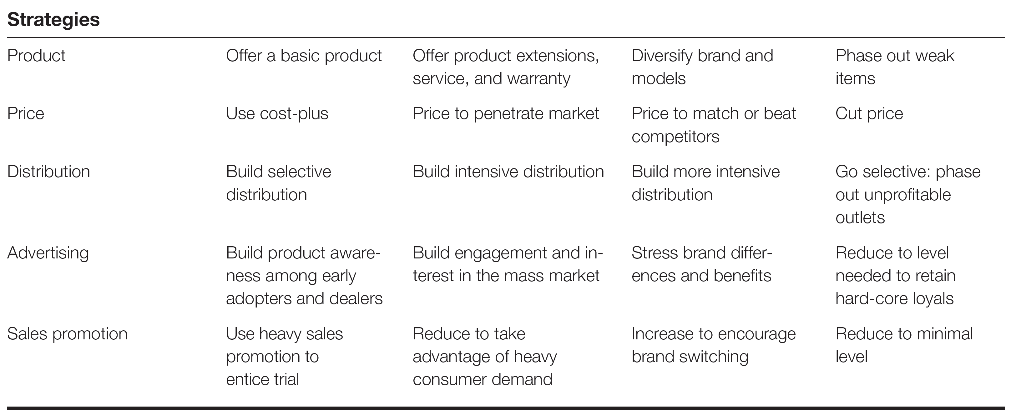
Product Life-Cycle Strategies
Table 9.2 Part II
Notes:
مكمل للجدول اللي قبله، اول شي الانتردكشن و و

